Slide 1
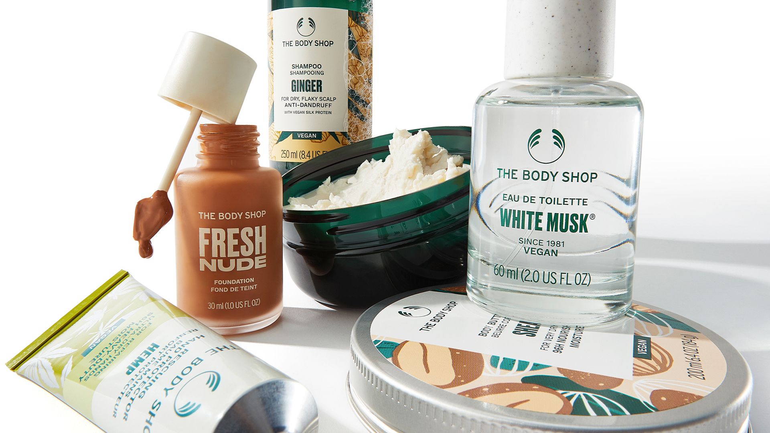

ICC PRE-CASE 2025
TEAM AFICIONADOS
IIT KANPUR

Slide 2



TEAM INTRODUCTION
TEAM MEMBERS
CONTACT NO.
COLLEGE
+91 98719 55126
MONI DUTT
IIT KANPUR
+91 98315 77605
ARIHANT SATPATHY
IIT KANPUR
AARUSH SINGH
IIT KANPUR
+91 81464 15628
ANURAG THAKUR
IIT KANPUR
+91 89105 87790
+91 90344 00498
KESHAV BANSAL
IIT KANPUR
SHIVAM TOMAR
IIT KANPUR
+91 92583 53826

Slide 3

executive summary
SOLUTION 1 Enhancing Supply Chain and Sustainability
1. Business Model and Industry Analysis
Solution Overview
Events and Influencer Partnerships
Understanding the Revenue Streams
Integrating AI within the Service
Unveiling Consumer Trends
Exploring Ayurvedic offerings
Analysing the Chinese Markets
Stating the Impact of each option
SOLUTION 2 Expanding Operations to Tier-2 and Tier-3
2. User Research and Competitive Landscape
Solution Overview
Gauging Public Sentiment about the Beauty and Personal Care Industry
Exploring Various Alternatives and Comparing Them
Opening Outlets and Exploring New Offerings
Performing an Industry Analysis
Leveraging Local Festivals
SOLUTION 3 Marketing Channels and User Engagement
Solution Overview
Customer Engagement
Appendix
Supply Chain and SWOT Analysis
Executive summary
Business Model
Industry
analysis
User Research
Comp Landscape
Solutions
Impact

Slide 4


Business Model
The Body Shop operates on a sustainable, ethical, and socially-conscious business model with a focus on natural, cruelty-free products.
Value Proposition
Revenue Streams
Target Customers
Natural Ingredients: Focus on products made with sustainably sourced, plant-based ingredients.
Ethical Practices: Strong stance against animal testing and commitment to fair trade practices.
Social Responsibility: Advocates for community-driven initiatives and global issues such as women's rights, biodiversity, and ethical trade.
Retail Sales: Primary revenue from physical stores in urban and semi-urban locations.
E-commerce: Direct-to-consumer (D2C) website and sales through marketplaces like Amazon and Nykaa.
Corporate Gifting and Partnerships: Customized solutions for gifting, especially during festive seasons.
Urban Millennials & Gen Z: Eco-conscious consumers valuing natural, cruelty-free, and premium products.
Socially Responsible Buyers: Customers supporting ethical trade and sustainability campaigns.
Health-conscious Demographic: Consumers preferring natural over chemical-based skincare and beauty products.
Executive summary
Business Model
Industry
analysis
User Research
Comp Landscape
Solutions
Impact

Slide 5
industry analysis
MARKET SIZE & GROWTH
KEY SEGMENTS
SLOWdown of china’s economy
Skincare contributes over 44% followed by haircare (20%), makeup (17%), fragrances (11%).
Organic and natural products are gaining significant traction, expected to surpass $20 billion by 2025.
Valued at approximately $296 Bn in 2022,projected to grow at CAGR of 6%
Asia-Pacific is the fastest growing contributing 40% of total revenue led by countries like China, India and South Korea
China’s beauty market grew only 3 percent—driven entirely by price growth, by volume it grows for about nearly 0 percent.
Macroeconomic factors, low consumer confidence, and widespread discounting (which led consumers to delay purchases for lower prices) impacted China's beauty sector performance.
SUSTAINABILITY & INNOVATION
CONSUMER TRENDS
.
Middle- and high-income consumers in China plan to increase beauty spending through 2024, while low-income consumers intend to spend less, potentially impacting the sector's performance.
The rise of vegan cosmetics is projected to grow the segment at a CAGR of 6-8% through 2030.
About 50% of consumers prefer brands emphasizing natural and sustainable sourcing
Millennials and Gen Z are the driving forces, focusing on sustainable, cruelty-free products.
E-commerce accounts for 25-30% of total sales, with online platforms becoming a key channel for cosmetics purchases.
Due to slow down of China, India emerges as the leading very high growth market in the industry of the year
Executive summary
Business Model
Industry
analysis
User Research
Comp Landscape
Solutions
Impact

Slide 6
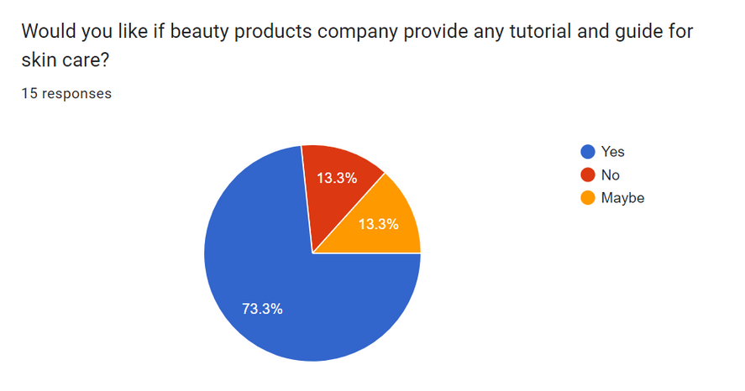

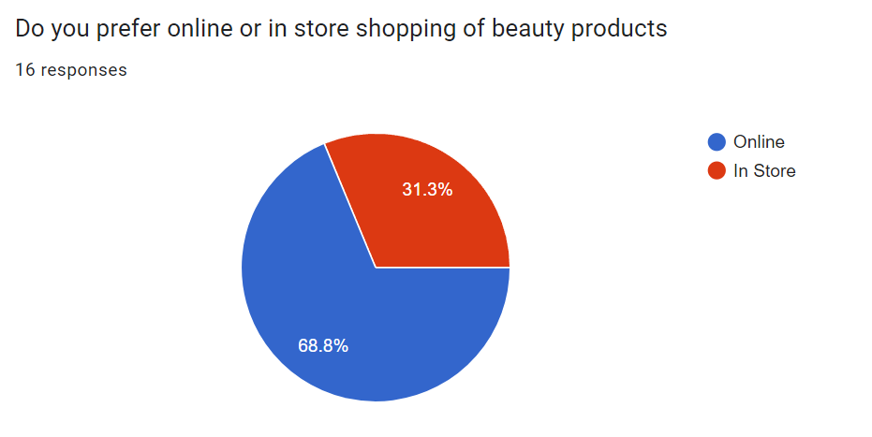
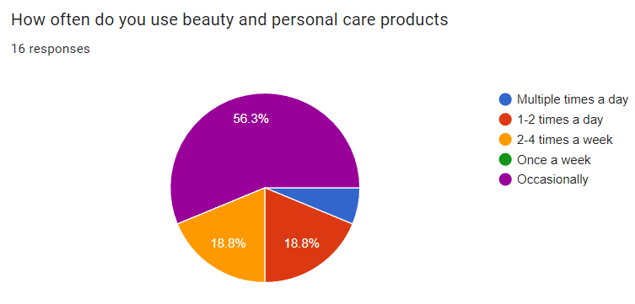
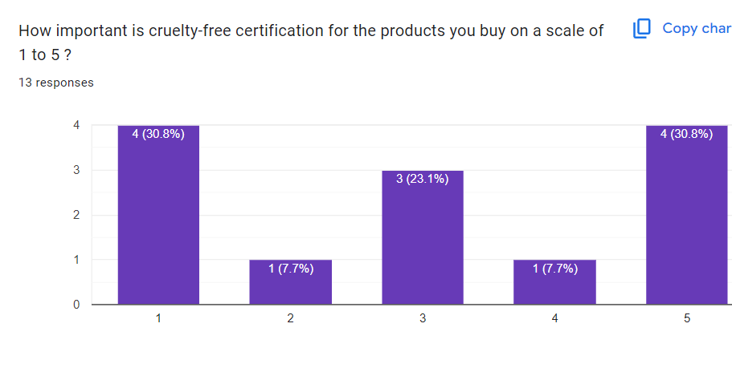
USER research
WE HAVE TAKEN ABOUT 200+ RESPONSES AND GOT THE FOLLOWING INSIGHTS
Executive summary
Business Model
Industry
analysis
User Research
Comp Landscape
Solutions
Impact

Slide 7






competitive landscape
Main Areas | Sustainable & ethical beauty | E-commerce & beauty retail | Luxury Ayurveda | Trendy & cruelty-free cosmetics | Natural & toxin-free products | Affordable beauty & cosmetics
Key Brands | The Body Shop | Nykaa Naturals, Kay Beauty | Forest Essentials, Babycare | Sugar, Aquaholic, Smudge Me Not | Mamaearth, The Derma Co., Aqualogica | Lakmé Absolute, 9to5, Iconic
Geography | Pan-India (urban focus) | Pan-India (Tier 1 & Tier 2 cities) | Premium urban areas in India | Pan-India (Tier 1 & Tier 2 cities) | Pan-India (strong digital presence) | Pan-India (urban & rural)
Demography | Youth & eco-conscious buyers | Millennials, Gen Z, working women | Premium consumers seeking Ayurveda | Young urban women, beauty enthusiasts | Families seeking toxin-free skincare | Mass-market consumers
Recent Events | Launched vegan products, refill stations | Launched global brands, offline expansions | Acquired SM Entertainment | Raised funding, expanded offline presence | Acquired BBLUNT, filed for IPO | Introduced natural formulations
ESG Score | 22.8 | 18.6 | 21.4 | 17.5 | 19.2 | 16.8
Executive summary
Business Model
Industry
analysis
User Research
Comp Landscape
Solutions
Impact

Slide 8
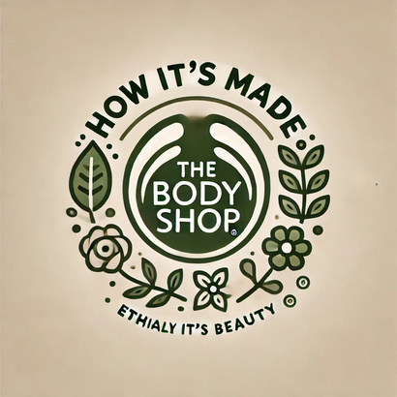

REVIVING SOCIAL MEDIA ENGAGEMENT
INITIATIVES
Introduce an annual “Cruelty-Free Day” where a percentage of sales goes to supporting animal welfare and ethical research initiatives. This reinforces brand integrity and resonates with a younger, ethically driven demographic
Influencer Collaborations: Identify 50-100 influencers with niche audiences aligned with Body Shop values, influencers who regularly post about sustainability, clean beauty advocates, and body positivity to attract young customers.
Target a mix of nano-influencers (5K-20K followers) and micro-influencers (20K-100K followers) for higher engagement rates.
"How It’s Made" Series: Create engaging videos or interactive digital content highlighting: Ingredient sourcing (e.g., showing fair trade partnerships), The manufacturing process, emphasizing cruelty-free and sustainable practice and Eco-friendly packaging solutions
IMPACT
The Cruelty-Free Day campaign will involve an estimated expense of ₹80L-1.2 Cr assuming we donate 5-10% of our daily sales for that day. 10–15% sales boost on the event day is expected along with an enhanced brand image among GenZ.
Influencer collaborations will need an estimated expense of ₹70-80L with an expected increase in customers count by 2-3 lakh. Revenues will directly be boosted by ₹10-15 Cr.
The How It’s Made Series will incur an expense of ₹30-35 lakh. The direct impact of this will be 10–15% retention improvement, ₹5–8 crore revenue boost.
*refer Appendix 1.1
Executive summary
Business Model
Industry
analysis
User Research
Comp Landscape
Solutions
Impact

Slide 9

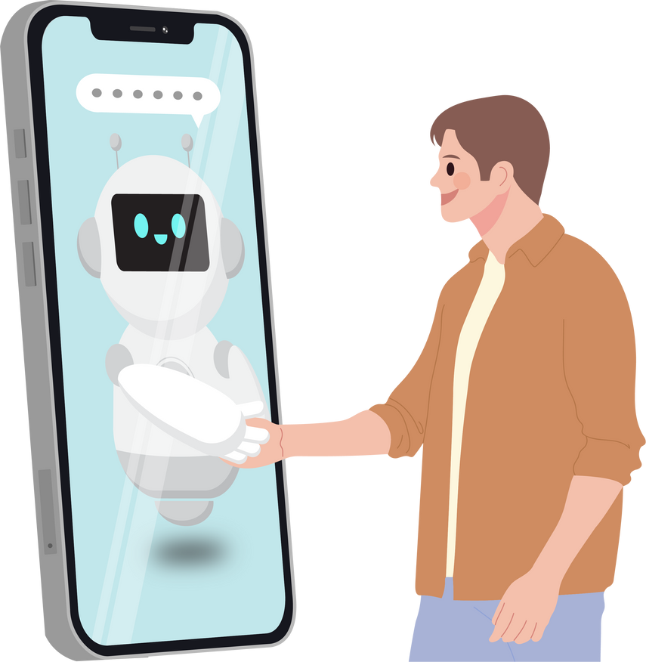
HYPER-PERSONALISATION USING AI
INITIATIVES
Launch “My Body Shop: Your Personalized Skincare Assistant” on the body shop website. This model will analyse the questions asked to the user using deep learning models. Based on the analysis, the app recommends products for different routines—day, night, seasonal care, and special treatments.
Launch “Body Shop SkinSync” device. The device will take information from the existing main app regarding the user’s choices. It will then analyse the input and accordingly provide the best mix and dispense the required moisturiser/ serum/foundation/lipstick
IMPACT
The company will incur a cost of around ₹ 1 Cr in the production and marketing of the skincare assistant. The R&D for the device will cost somewhere around ₹ 2 Cr. Initial manufacturing and marketing costs of around ₹ 2-3 Cr in total. This total spend will be almost 1.5% of the revenue for the year.
A 25-30% increase in conversion rates is expected on the website thanks to the assistant model.
High engagement from owning a personalized device leads to increased brand loyalty and repeat product sales for refills, boosting long-term revenue by 10-20% per user.
Introducing a smart skincare device would position The Body Shop as a tech-driven, innovative player in the beauty market, attracting tech-savvy, youthful consumers.
*refer Appendix 1.1
Executive summary
Business Model
Industry
analysis
User Research
Comp Landscape
Solutions
Impact

Slide 10


AYURVEDIC AND HERBAL BLENDS
INITIATIVES
Launch a sub-brand named TBS Prakriti inspired by Ayurvedic principles, blending traditional Indian herbs with modern formulations for skincare, haircare, and wellness.
Offer customizable herbal oils or DIY kits where customers can create their own blends using essential oils and natural additives. Features will include : allowing customers to choose their base oils (e.g., jojoba, almond, coconut), essential oils (e.g., lavender, rose, tea tree), and additional elements (e.g., aloe vera powder, turmeric, vitamin E) for a fully personalized experience.
Provide informative cards or a digital guide with each kit that explains the benefits of each ingredient, how to blend them, and how to use the product for the best results. Include tips on dosages and ratios to avoid misuse.
IMPACT
Brand is expected to incur an expense of ₹10 Cr for the product development and marketing as first time expenses.
The cost of manufacturing DIY kits can be low due to simple ingredients (e.g., essential oils, base oils). The personalized experience adds perceived value, allowing for a premium pricing model, this will allow us to have high profit margins of more than 50% on the item.
TBS Prakriti could capture 5–8% of the Indian Ayurvedic skincare market in its first year, translating to ₹40–60 crore in annual revenue.
Opens opportunities for global export, particularly to regions with high demand for Ayurveda (e.g., the US, Europe, and Southeast Asia) where the Ayurvedic segment is expanding at CAGR of 15–20% .
*refer Appendix 1.1
Executive summary
Business Model
Industry
analysis
User Research
Comp Landscape
Solutions
Impact

Slide 11

EXPANSION INTO TIER 2 AND TIER 3 CITIES
IMPROVED GROWTH PROSPECTS
POSSIBLE INITIATIVES
OVERVIEW
INCREASED PROFITABILITY
RISKINESS OF IMPLEMENTATION
INCREASED OUTREACH
Collaborate with micro and nano-influencers to connect with regional audiences authentically.
Improved Influencer Marketing
Align product launches and promotions with local festivals and events
Local Festivals
Expand its footprint by increasing the number of stores in Tier 2+ cities .Set up smaller, low-CAPEX kiosks in malls or high-footfall areas
Increasing the Number of Stores
Introduce smaller, travel-sized versions of popular products
Launch smaller versions of products to lower the entry price point.
AS MUCH AS 40% POPULATION OF INDIA WILL BE URBANIZED BY 2030

Slide 12
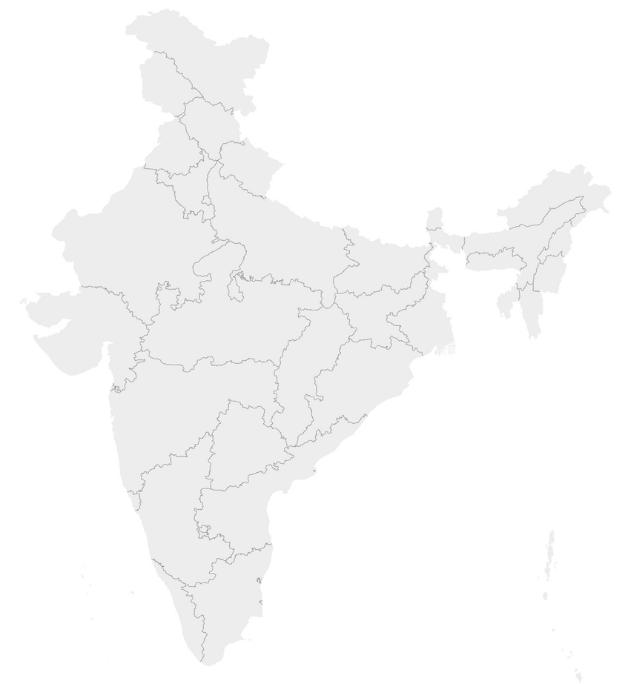
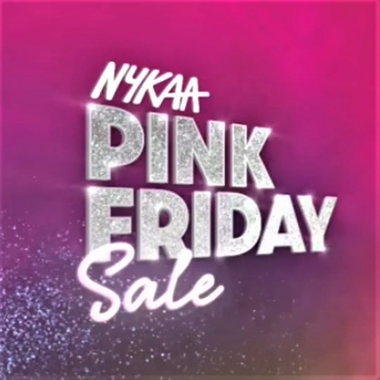
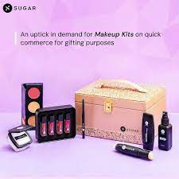
EXPANSION INTO TIER 2 AND TIER 3 CITIES
The Body Shop can expand by offering franchises to local entrepreneurs, minimizing direct CAPEX and enabling rapid store growth with limited capital investment. Combined with collaborations with local retailers, referral schemes, and pop-up events in non-metro cities , this approach can effectively enhance market penetration and brand visibility as done by Nykaa .
Total Size of Beauty and Personal Care Industry In India
The Body Shop can introduce eco-focused loyalty programs to drive repeat purchases and customer retention:
Eco-Loyalty Points: Reward eco-friendly purchases and referrals, reinforcing the brand's sustainability ethos.
Exclusive Member Offers: Provide early access to sales and exclusive promotions for loyalty members.
Subscription Boxes: Launch curated skincare kits (monthly or quarterly) to replicate the success of Sugar and create consistent engagement.
These strategies, inspired by Nykaa’s “Pink Fridays” and Sugar’s subscription models, can build long-term customer loyalty and drive recurring revenue.
USD 17B
USD 11 B
Total Size of Beauty and Personal Care Industry In Tier 2+ Cities
Executive summary
Business Model
Industry
analysis
User Research
Comp Landscape
Solutions
Impact

Slide 13
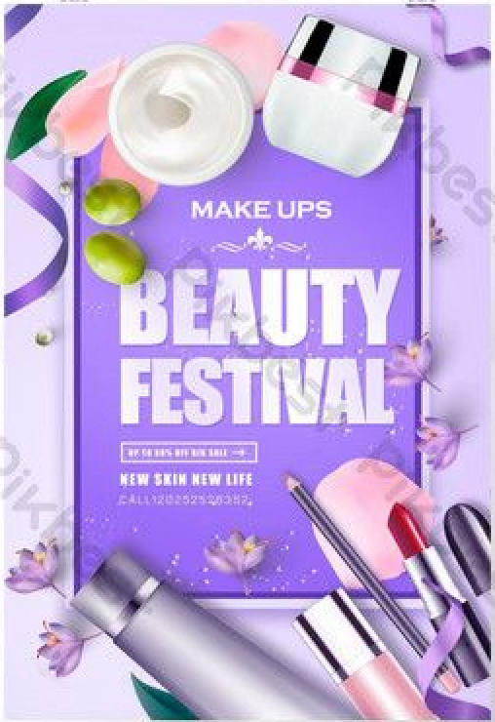
EXPANDING IN TIER 2 AND TIER 3 CITIES BY LEVERAGING LOCAL FESTIVALS
INITIATIVES
1) Packaging
a) Collaborate with local artisans to create festival-specific packaging that reflects regional traditions and languages, enhancing
Differentiates The Body Shop’s products with unique, culturally relevant packaging.
Builds brand loyalty by connecting with regional identities and traditions.
2) Special Product Launches
a) Holi Color Care Collection
Offer: Spend ₹1,500 and get 20% off + free Aloe Vera Gel for post-Holi skin.
Campaign: “Care Beyond Colors” featuring hydration and protection essentials, promoted via influencer tutorials.
b) Women’s Day Self-Care Kit
Offer: Self-care bundles for ₹1,499 with Body Butter, Lip Balm, and Relaxation Mist.
Campaign: “Empowered Skin, Empowered You” with workshops, donation drives, and ethical sourcing highlights.
c) Men’s Day Grooming Box
Offer: 15% off on purchases above ₹1,000 featuring Maca Root Shaving Cream and Face Scrub.
Campaign: “Celebrate the Gentlemen” with fitness influencers promoting men’s grooming routines.
IMPACT
Revenue Growth: Festival sales can boost monthly revenues by 30%-40% during peak festival periods.
Customer Base Expansion: Increased penetration into Tier 2 and Tier 3 cities, growing regional consumer loyalty.
Brand Equity: Strengthened positioning as a socially conscious, premium brand that respects local traditions.
Executive summary
Business Model
Industry
analysis
User Research
Comp Landscape
Solutions
Impact

Slide 14


Commitment to Sustainability
I
INITITATIVES
Minimalist formulations such as waterless cosmetics use fewer resources in production as well as in transportation and packaging. In addition, formula with decreased water content are less prone to microbial contamination and thus reduces need for additives such as emulsifiers and preservatives
Partner with local recycling organizations, municipal waste systems, and global networks to ensure packaging can be effectively recovered and processed.
Include biotechnological technologies that transform biomass waste or CO2 into cosmetic components or bioplastics. This aligns with the principles of a circular economy, emphasizing sustainability and resource efficiency.
Shift 100% of delivery and transportation operations to electric vehicles (EVs) or other green freight options by 2030 to reduce supply chain emission
Showcase the company’s commitment to sustainability through in-store displays and campaigns.
Initiatives
IMPACT
Reduction in emissions during transportation by 10-20% due to lower weight and volume of waterless products
Initial adoption of bioplastics could reduce conventional plastic use by 10-15% within 1-2 years
By integrating circular economy principles, CO2 emissions could decrease by up to 40% in 5-10 years.
Use route optimization software to reduce fuel consumption and maximize EV efficiency.
Executive summary
Business Model
Industry
analysis
User Research
Comp Landscape
Solutions
Impact

Slide 15
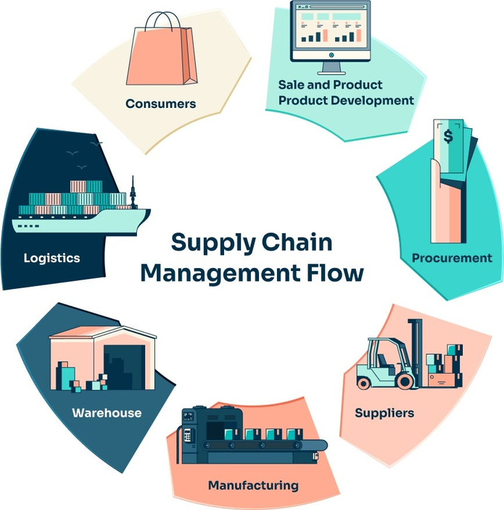
Strengthen Supply Chain Operations
INITIATIVES
Ethical Sourcing and Transparency: Use blockchain technology to provide traceability of ingredients from sourcing to finished products, building trust with consumers
Implement AI-driven demand forecasting tools to ensure optimal inventory levels across stores and e-commerce channels.
Strengthen Supplier Relationships: Partner with ethical suppliers, especially in regions where The Body Shop sources raw materials (e.g., shea butter from Ghana or tea tree oil from Kenya). Work closely with suppliers to ensure fair wages, safe working conditions, and sustainable farming practices and give them a legal contract and not just dependency on trust.
IMPACT
Brands using blockchain for supply chain transparency report up to a 20% increase in customer retention and a 15-20% boost in sales from ethically conscious consumers.
AI-driven demand forecasting can reduce inventory holding costs by 10-30%, while improving stock availability by 5-10%, leading to a long-term revenue by 10-20% per user..
Fair wages and sustainable practices can boost supplier productivity by 15-20%, while reducing supply chain disruptions by 30%, resulting in cost savings of up to 10% annually.
Executive summary
Business Model
Industry
analysis
User Research
Comp Landscape
Solutions
Impact

Slide 16






Customer Social Media Engagement
Awareness
Branded hashtag campaigns
Launch campaigns like #DIYWithBodyShop, encouraging users to share DIY skincare recipes. This builds brand awareness through organic social sharing.
Engagement
Customer experiences and interactions
Motivate users to share their experiences with products, generating branded content that sparks likes, comments, and shares.
Consideration
Discounts, samples, and giveaways
Offer discounts, free samples, and giveaway entries for user participation, creating incentives for potential buyers to interact.
Intent
Exclusive rewards and incentives
Run competitions for larger prizes, such as a year’s supply of products or exclusive workshops. This deepens intent and interest.
Purchase
Personalized storytelling and recognition
Develop features like Spotify’s “Wrapped”, showcasing customer purchases and contributions to sustainability, encouraging purchase behavior.
Advocacy
User-generated content and loyalty
Highlight individual stories, promoting long-term advocacy. Reward and recognize customers who share their experiences, reinforcing loyalty and trust.
Executive summary
Business Model
Industry
analysis
User Research
Comp Landscape
Solutions
Impact

Slide 17
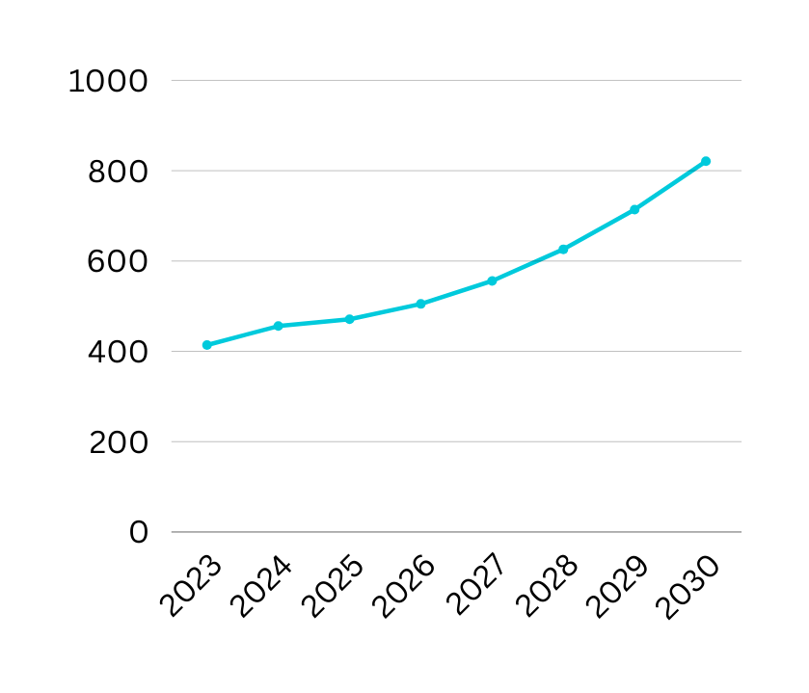

impact
Significant expenses early on will slow growth, especially in the first two years.
Revenue in 2025 sees a modest 3% growth due to the start of the investments and initiatives, but the real returns won't materialize until later
SHORT TERM IMPACT(2024-25)
The AI assistant, influencer marketing, and Prakriti sub-brand help increase customer retention and sales.
The launch of DIY kits and the AI assistant will improve customer experience, leading to higher conversion rates.
MID TERM IMPACT(2026-27)
The AI-driven personalization, device launch, and Prakriti's market position should lead to a more diversified revenue stream.
The full effect of these strategies will likely show between 2028-2030, with a compounded growth rate of 12-15% annually.
LONG TERM IMPACT(2028-30)
Revenue Projections (in Cr)
*Refer Appendix 1.4
Executive summary
Business Model
Industry
analysis
User Research
Comp Landscape
Solutions
Impact

Slide 18
THANK YOU

Slide 19
APPENDIX

Slide 20

Supply chain
Manufacturing and Production
Packaging
Quality Control and Compliance
Centralized and Outsourced Model
Body Shop sources ingredients through its Community Fair Trade (CFT) program, maintain partnerships with small-scale farmers, artisans, and producers such as: Shea Butter from women’s cooperatives in Ghana. Tea Tree Oil from organic farmers in Kenya.
Works closely with suppliers to provide training, resources, and tools that enable them to meet The Body Shop’s ethical standards
Eco-Friendly Initiatives
Recyclable Materials: Currently, more than 68% of the packaging can technically be recycled
By 2025, they claim all their bath and body and haircare products will be fully recyclable.
Today, their PET plastic product packaging contains on average 25% recycled material
All body shop’s boxes are reversible/reusable with the exception of our largest box format..
Certifications
B Corp Certification: Ensures that the company meets the highest standards of social and environmental performance.
Leaping Bunny Program: Guarantees no animal testing at any stage of production.
Regulatory Compliance
Adheres to strict regulatory requirements for sustainability, ingredient safety, and ethical practices in all operating countries.

Slide 21
SWOT ANALYSIS
S
W
STRENGTHS
WEAKNESS
High Brand Loyalty,Good Quality Products and Services
A Brand Image Associated with Ethics,Values and Natural Ingredients.
High Operating Costs
Sales Volume Restricted by Limited Number of Outlets
Faces stiff competition from established local brands and international entrants
O
T
OPPORTUNITIES
THREATS
Increasing Awareness about Eco-Friendly Products
Increasing Purchasing Powers of Customers
Entry of new international and domestic brands with similar ethical and natural positioning intensifies competition.
A predominantly price-sensitive market could deter potential customers

Slide 22
appendix 1.1
For the estimate on similar day campaigns by Lush Cosmetics and Aveda, both cruelty-free brands, have reported short-term boosts in daily sales by 10-15% on promotional days.
Brands like Nykaa and Forest Essentials have effectively used influencer partnerships, spending ₹50-100 lakh per campaign and acquiring around 1.5-3 lakh new customers.
For The Body Shop, assuming an average order value (AOV) of ₹2,000-3,000 and targeting 2-3 lakh new customers, the potential revenue boost is approximately ₹10-15 crore.
Lush Cosmetics, has successfully implemented similar campaigns to promote transparency like our “How its made” series that improved customer retention by 12-20% and boosted annual revenue by 7-10%.
For the skincare assistants, similar AI models developed by Sephora and Estée Lauder incurred $100K-$150K (₹75 lakh - ₹1.1 crore) in development and launch costs. So we estimate a similar cost for our AI assistant.
Nykaa’s AI-powered beauty advisor led to a 20-25% increase in conversion rates by offering personalized recommendations, especially in skincare and makeup. Considering the higher percentage of upper middle class users using the platform, we expect the conversion rate to be slighty more than the same.
For our DIY kits an expected profit margin of 50-60% is justified. Big players like MamaEarth, Forest cosmetics and DECIEM have similar versions of their own DIY kits which they sell at margins of 60-80%. This can be explained by a breakdown of pricing. The ingredients in the pack that we choose will vary from ₹50-₹100. Packaging will be between ₹20-₹30. The guide will cost another ₹10-₹20. Including overheads, the total cost will be somewhere between ₹100-₹200. Even at 100% profit margin, we’ll be able to sell them for a discount than the competitors that usually offer a price of ₹400-₹500 for their DIY kits.

Slide 23
appendix 1.2
Nykaa’s festive campaigns, like Diwali and Pink Friday Sales, boosted monthly revenues by over 35%, driven by deep discounts, exclusive launches, and influencer-led promotions.
By targeting Tier 2 and Tier 3 cities through pop-up stores and regional campaigns, Nykaa grew its non-metro customer base by 40% in 2022.
Sugar’s limited-edition festive kits during Raksha Bandhan and Diwali contributed to a 25%-30% revenue increase during the festive quarter.
Aggressive regional influencer campaigns and affordable festival bundles helped Sugar penetrate Tier 2/3 cities, growing its market share by 15% in 2022.
Sugar positioned itself as a trendy, affordable, yet high-quality brand through culturally relevant campaigns.
Seasonal campaigns for products like festive makeup kits during Diwali and wedding seasons consistently boosted sales by ~30%-40%.
Customer Base Expansion: Through targeted festival offers and regional language marketing, Lakmé gained a foothold in Tier 2 and Tier 3 markets.

Slide 24
appendix 1.3
Blockchain-backed transparency campaigns can drive short-term sales boosts of 12-18%, similar to those seen by ethical brands like Patagonia. Implementation costs typically range from ₹75 lakh to ₹1.5 crore, depending on complexity. By attracting 1-2 lakh new customers with an AOV of ₹2,000-3,000, brands can achieve a potential revenue boost of ₹20-60 crore. Additionally, transparency can improve customer retention by 12-20% and conversion rates by 2-3%, offering a long-term strategic advantage and sustained revenue growth.
In 2020, L’Oréal reduced its CO2 emissions per unit of production by 76% compared to 2005 levels, despite the increase in production volume. This reduction was driven by energy-efficient manufacturing processes and circularity in packaging.
The company aims to achieve a 40% reduction in CO2 emissions in its supply chain by 2030, relying on circularity practices such as recycled materials in packaging
In 2019, Unilever improved the transportation efficiency of its products by reducing packaging weight, which led to a 15% reduction in carbon emissions from its logistics operations.
Aveda’s adoption of waterless products would complement its existing strategy to lower transportation emissions, as the reduced size and weight of these products would provide an additional 10-20% reduction in emissions during transit.

Slide 25
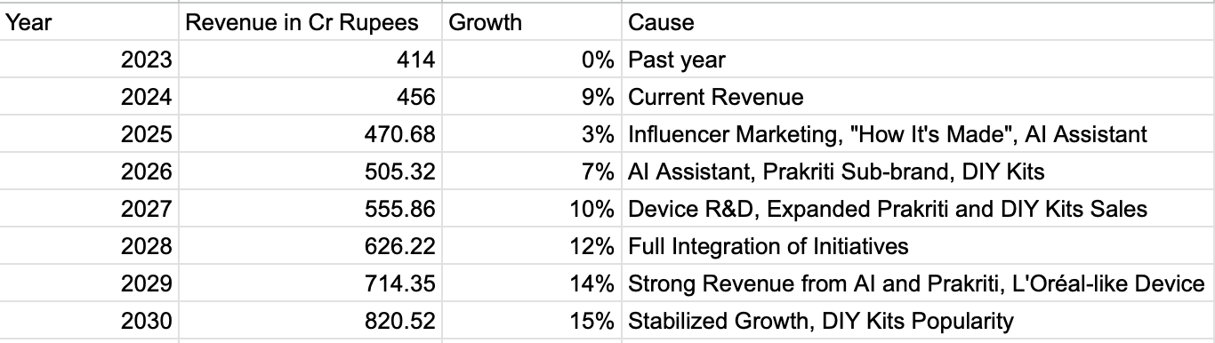
appendix 1.4
Data used for growth projection based on advised initiatives

Slide 26
SOURCE
REVENUE IMPACT OF INFLUENCER MARKETING
IMPACT OF TRANSPARENCY IN SUPPLY CHAIN
SUSTAINABILITY MEASURES
MODERN SLAVERY REPORT
ISRAELI BRAND ODDETIY REPORTED REVENUE BOOST DUE TO SALE OF DEVICE SIMILAR TO PROPOSED BODY SHOP SKINSYNC
INFLUENCER RATES
GROWTH IN THE INDUSTRY
INDIA’S COSMETIC MARKET
DIY KITS LEADING TO SALES BOOST
EXPANSION TO TIER2 AND TIER3 CITIES
INDUSTRY ANALYSIS DATA

